Slide 1
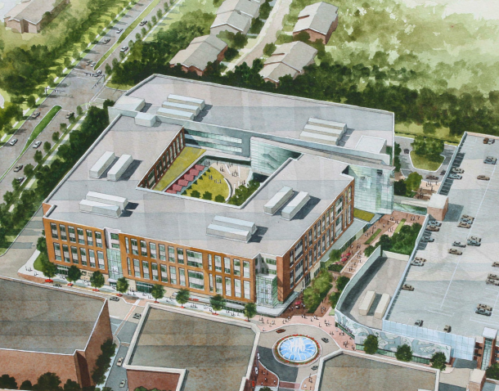
Corporate Headquarters
Great Lakes Region, USA
AE Senior Thesis
April 13th, 2015
Mary Julia Haverty
Structural Option
Advisor H. Sustersic
Image Courtesy: RTKL

Slide 2
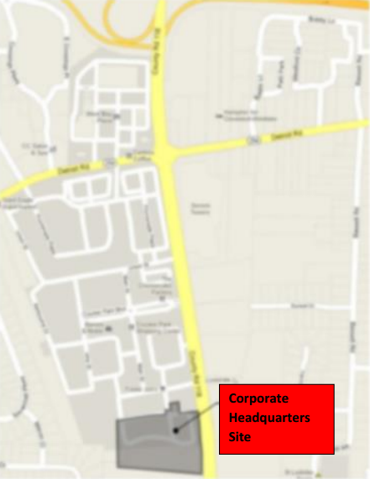
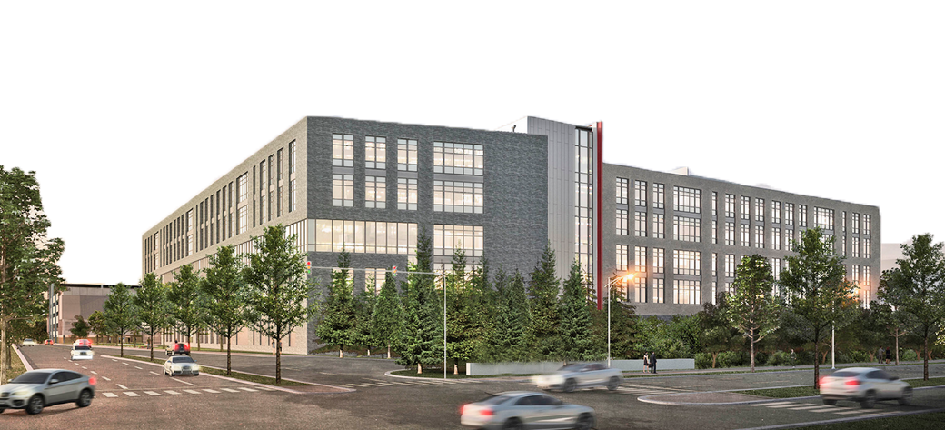
Corporate Headquarters
Introduction
Problem Statement and Solution
Structural Depth
Gravity System
Lateral System
Green Roof Breadth
Enclosures Breadth
Conclusion
Introduction
Building Height: 83.33’
Number of Stories: 5
Size: 659,554 GSF
Occupancy: Office and Retail
Location: Great Lakes Region
Cost: Withheld at owner’s request
Dates of Construction:
August 2014- Spring 2016
Project Delivery Type:
Design-Bid Build
Project Team
RTKL: Architect, Structural Engineer, Mechanical Engineer, Electrical Engineer, Plumbing, Telecommunications
Mark G. Anderson Consultants: Project Management
Neff and Associates: Civil Engineer
Keith Davis Group, LLC: Roof and Waterproofing Consultant
Image Courtesy: RTKL and The Village Newspaper

Slide 3
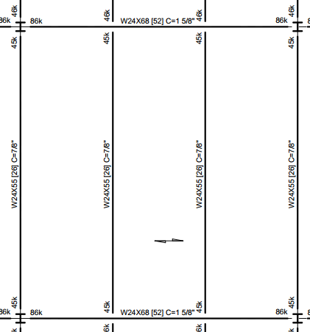
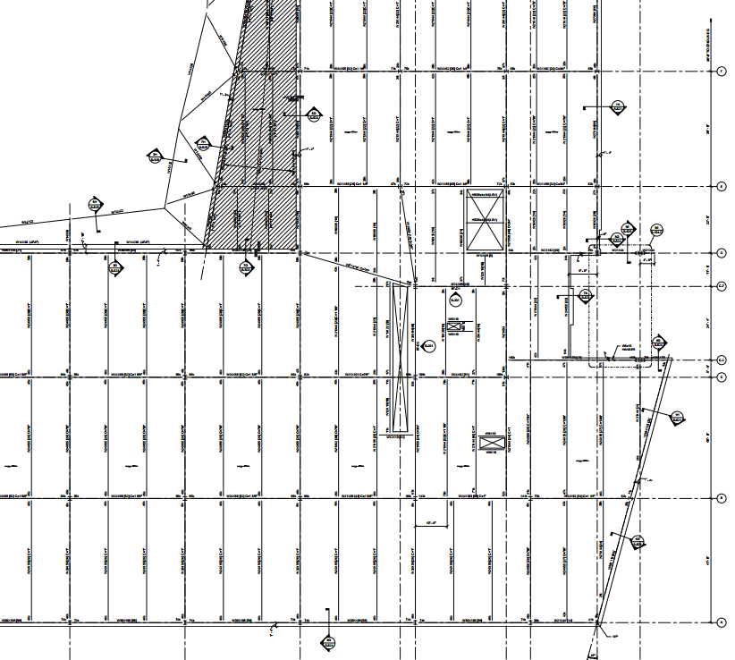
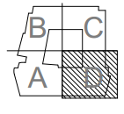
Corporate Headquarters
Introduction
Existing Structural System
Gravity System
Lateral System
Problem Statement and Solution
Structural Depth
Gravity System
Lateral System
Green Roof Breadth
Enclosures Breadth
Conclusion
Existing Structural System
Gravity System
Composite Steel Beams and Girders
  beams spaced at 12.67’
  average camber 1”
  Average beam size W24x55
  Average girder size W24x68
Wide Flange Columns
  spliced at level 3
  Average column size W14x90
Design Loads
40’
N
38’

Slide 4
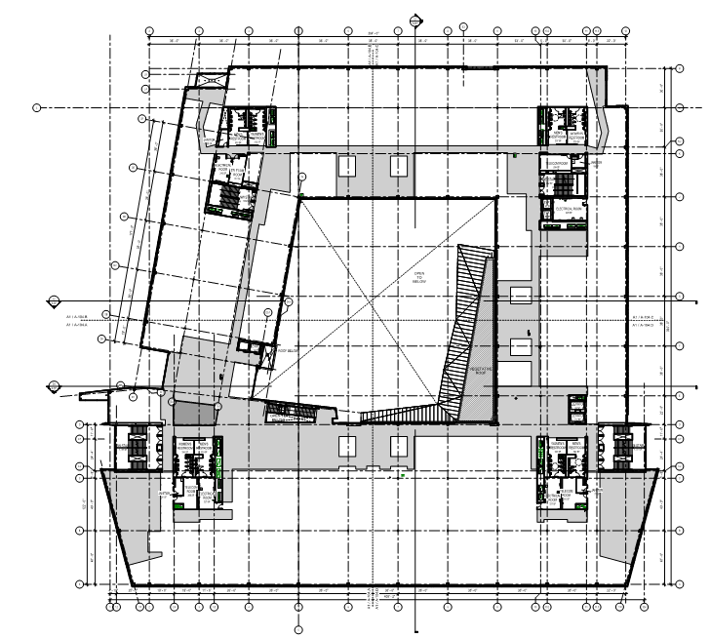
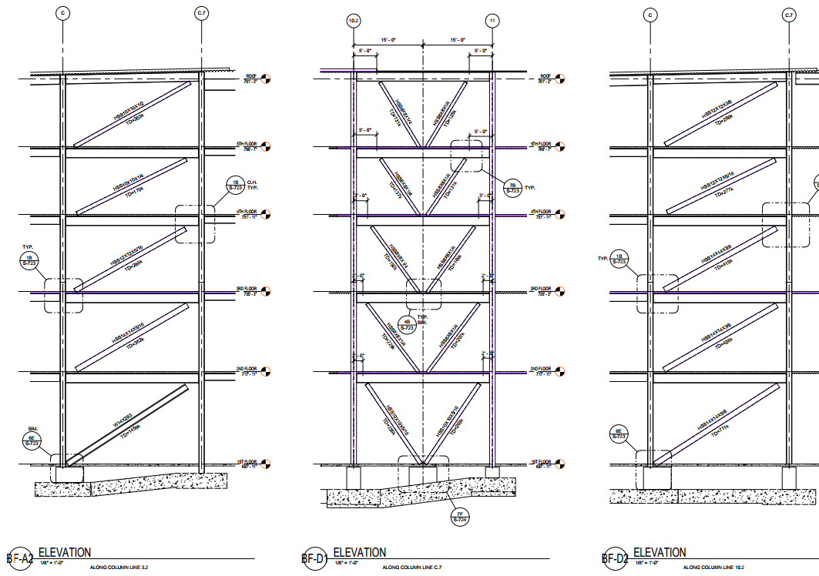
Corporate Headquarters
Introduction
Existing Structural System
Gravity System
Lateral System
Problem Statement and Solution
Structural Depth
Gravity System
Lateral System
Green Roof Breadth
Enclosures Breadth
Conclusion
Existing Structural System
Lateral System
Steel braced frames
Two in each corner of the building, eight total
Wind Loading
V=90 mph
Base shear East-West= 423.16 kips
Base shear North-South= 353.62 kips
Seismic Loading
Site Class C
Seismic Design Category A
Base shear 572.35 kips
N
Notes:
Braced frames are fully enclosed inside walls

Slide 5
Corporate Headquarters
Introduction
Problem Statement and Solution
Structural Depth
Gravity System
Lateral System
Green Roof Breadth
Enclosures Breadth
Conclusion
Problem Statement
Scenario:
Owner has requested more office space
Goals:
1. Reshape courtyard green roof
  Aid in design process, more regular bays
  Remove tree area to reduce dead load
  Gain office space on upper three floors

Slide 6
Corporate Headquarters
Introduction
Problem Statement and Solution
Structural Depth
Gravity System
Lateral System
Green Roof Breadth
Enclosures Breadth
Conclusion
Problem Statement
Scenario:
Owner has requested more office space
Goals:
1. Reshape courtyard green roof
  Aid in design process, more regular bays
  Remove tree area to reduce dead load
  Gain office space on upper three floors
2. Redesign structural system to support new dead load
  Utilize open web steel joists and joist girders

Slide 7
Corporate Headquarters
Introduction
Problem Statement and Solution
Structural Depth
Gravity System
Lateral System
Green Roof Breadth
Enclosures Breadth
Conclusion
Problem Statement
Scenario:
Owner has requested more office space
Goals:
1. Reshape courtyard green roof
  Aid in design process, more regular bays
  Remove tree area to reduce dead load
  Gain office space on upper three floors
2. Redesign structural system to support new dead load
  Utilize open web steel joists and joist girders
3. Explore new planting options and watertight systems
  Redesign garden to focus on local plants
  Select new waterproofing membrane

Slide 8
Corporate Headquarters
Introduction
Problem Statement and Solution
Structural Depth
Gravity System
Lateral System
Green Roof Breadth
Enclosures Breadth
Conclusion
Gravity System

Slide 9
Corporate Headquarters
Introduction
Problem Statement and Solution
Structural Depth
Gravity System
Gravity Loads
Typical Roof Bay
Typical Floor Bay
Columns
Vibration Considerations
Lateral System
Green Roof Breadth
Enclosures Breadth
Conclusion
Gravity Loads

Slide 10
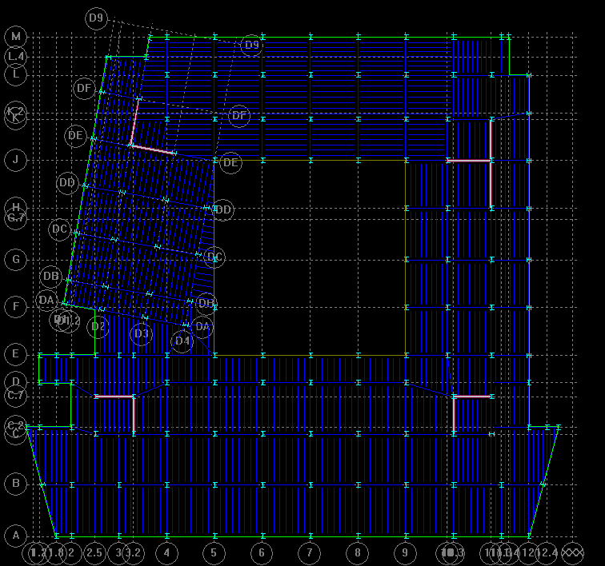
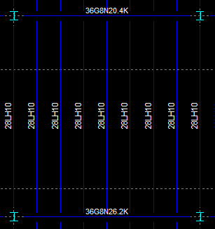
Corporate Headquarters
Introduction
Problem Statement and Solution
Structural Depth
Gravity System
Gravity Loads
Typical Roof Bay
Typical Floor Bay
Columns
Vibration Considerations
Lateral System
Green Roof Breadth
Enclosures Breadth
Conclusion
Gravity System- Typical Roof Bay
Steel Joist System Roof Redesign
38’
Typical Bay
1.5 VLR 18 gauge composite deck
4” normal weight topping
  Achieves two hour fire rating
Unshored, 2 span construction
Joists
28LH10
4.75’ spacing
Joist Girders
36G8N26.2K
Joists and girders to be fire proofed for a two hour fire rating
Deflection controlled depths
Designed using RAM Structural System
40’
N

Slide 11
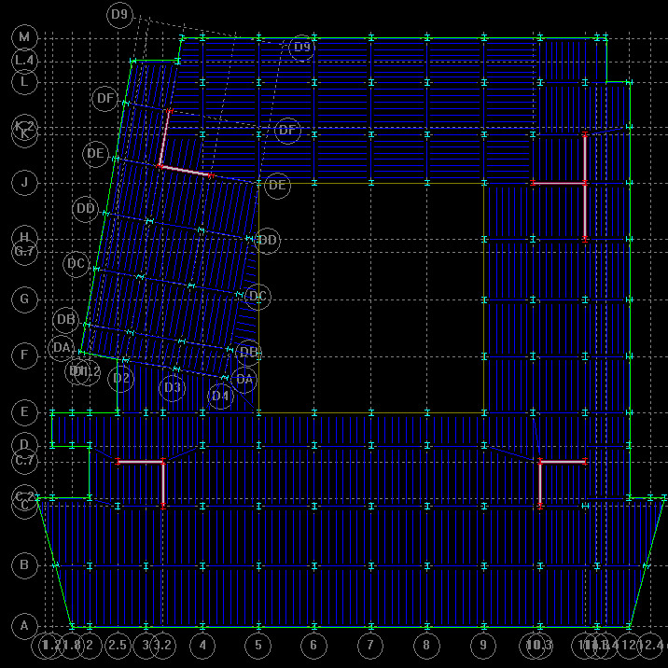
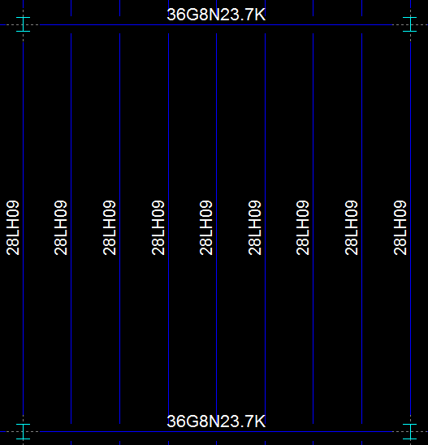
Corporate Headquarters
Introduction
Problem Statement and Solution
Structural Depth
Gravity System
Gravity Loads
Typical Roof Bay
Typical Floor Bay
Columns
Vibration Considerations
Lateral System
Green Roof Breadth
Enclosures Breadth
Conclusion
Gravity System- Typical Floor Bay
Steel Joist System Floor Redesign
Typical Bay
1.5 VLR 18 gauge composite deck
3 ¼” lightweight topping
  Achieves two hour fire rating
Unshored, 2 span construction
Joists
28LH09
4.75’ spacing
Joist Girders
36G8N23.7K
Joists and girders to be fire proofed for a two hour fire rating
Deflection controlled depths
38’
40’
N

Slide 12
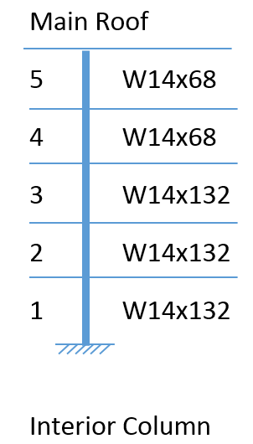
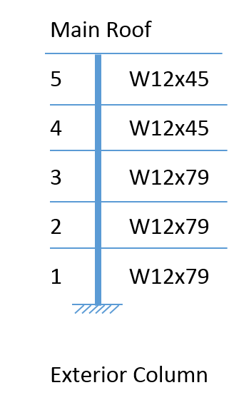
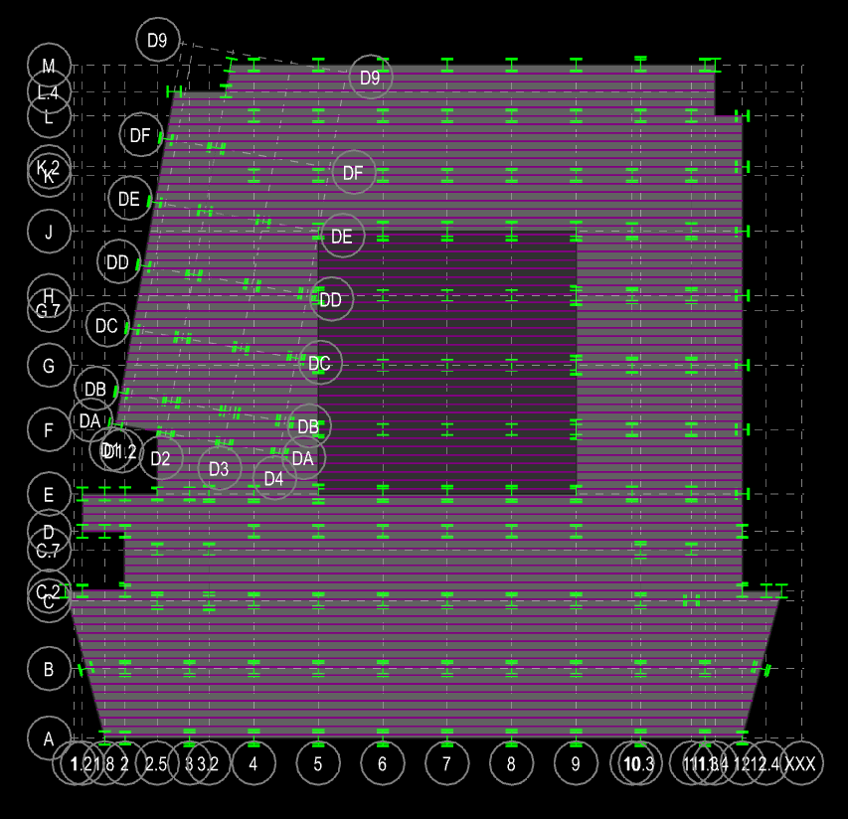

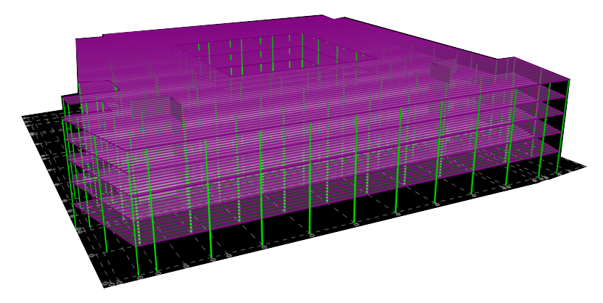
Corporate Headquarters
Introduction
Problem Statement and Solution
Structural Depth
Gravity System
Gravity Loads
Typical Roof Bay
Typical Floor Bay
Columns
Vibration Considerations
Lateral System
Green Roof Breadth
Enclosures Breadth
Conclusion
Gravity System- Columns
Wide flange steel columns
Typical sizes
  W14x132 (interior)
  W12x79 (exterior)
Spliced on level 3
Designed using RAM Structural Systems- Columns
Live Load Reduction
L=41 psf
Lo=65 psf
KLL=1.0
At=38’x40’ = 1520 sq ft
N

Slide 13
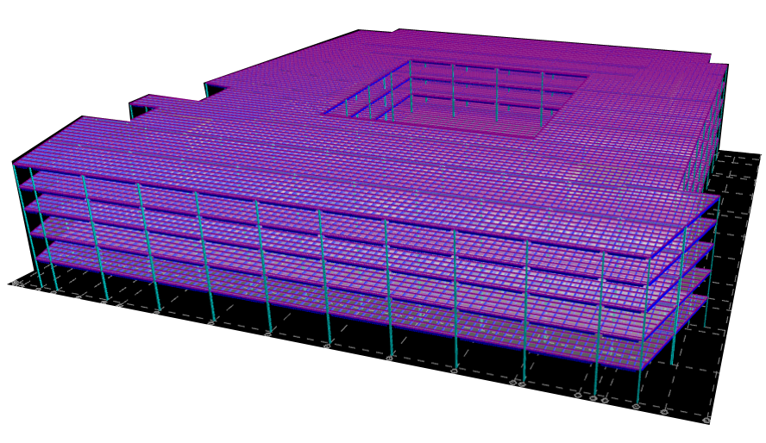

Corporate Headquarters
Introduction
Problem Statement and Solution
Structural Depth
Gravity System
Gravity Loads
Typical Roof Bay
Typical Floor Bay
Columns
Vibration Considerations
Lateral System
Green Roof Breadth
Enclosures Breadth
Conclusion
Gravity System- Vibration Considerations
Major area of concern in steel joist floor systems
Helped limit joist spacing
Upper floors of building primary concern
Ap/g < 0.005 for office areas
Fn= 2.6 Hz
Ap/g = 0.0015
Criteria found in AISC Design Guide 11, Ch 4, Design for Walking Excitation
N

Slide 14
Corporate Headquarters
Introduction
Problem Statement and Solution
Structural Depth
Gravity System
Lateral System
Green Roof Breadth
Enclosures Breadth
Conclusion
Lateral System

Slide 15
Corporate Headquarters
Introduction
Problem Statement and Solution
Structural Depth
Gravity System
Lateral System
Lateral Loads
Shear Wall Design
Story Drift
Green Roof Breadth
Enclosures Breadth
Conclusion
Lateral System- Lateral Loads
East-West Wind Pressures Now Control

Slide 16
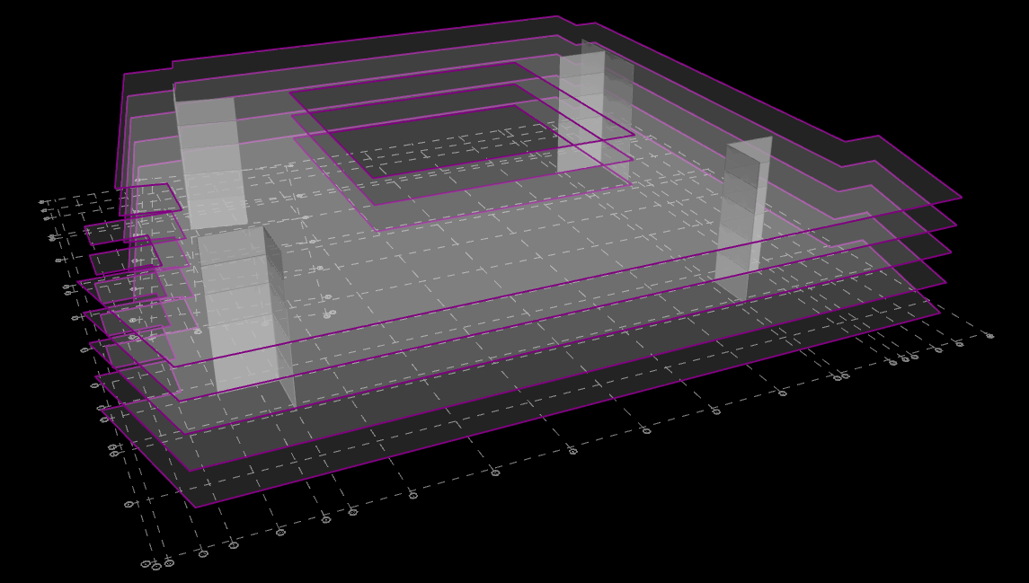
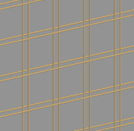
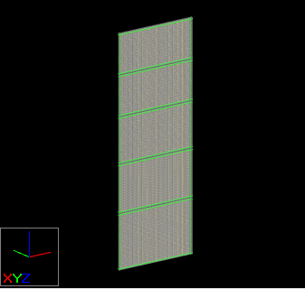
Corporate Headquarters
Introduction
Problem Statement and Solution
Structural Depth
Gravity System
Lateral System
Lateral Loads
Shear Wall Design
Story Drift
Green Roof Breadth
Enclosures Breadth
Conclusion
Lateral System- Shear Wall Design
Reinforced Concrete Shear Walls
Eight reinforced concrete shear walls
Retained locations of existing lateral system
Reinforced with minimum reinforcement
#4’s at 12” O.C. horizontal and vertical
8” thickness
N
Notes:
Two curtains of reinforcement
6” thickness technically meets code but distance between curtains would only be 1”, so for constructability, 8” shall be used

Slide 17

Corporate Headquarters
Introduction
Problem Statement and Solution
Structural Depth
Gravity System
Lateral System
Lateral Loads
Shear Wall Design
Story Drift
Green Roof Breadth
Enclosures Breadth
Conclusion
Lateral System- Story Drift
Wind drift limit
Seismic drift limit
Notes:
Seismic allowable story drift
14.67 is lowest floor to floor height

Slide 18
Corporate Headquarters
Introduction
Problem Statement and Solution
Structural Depth
Gravity System
Lateral System
Green Roof Breadth
Enclosures Breadth
Conclusion
Green Roof Breadth

Slide 19
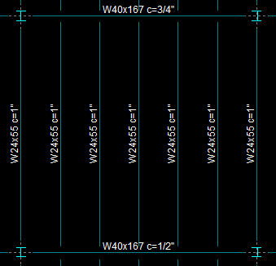
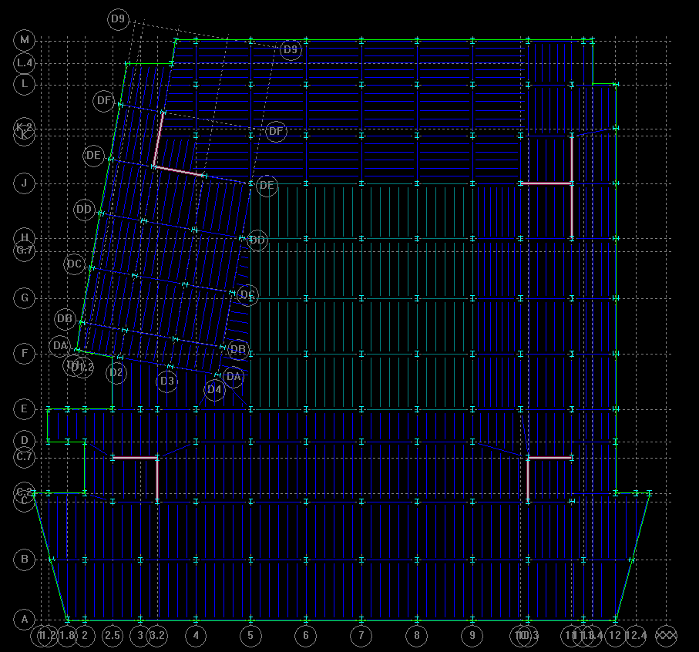
Corporate Headquarters
Introduction
Problem Statement and Solution
Structural Depth
Green Roof Breadth
Loading and Framing
Design and Materials
Enclosures Breadth
Conclusion
Green Roof Breadth- Loading and Framing
Tree area removed in order to decrease dead load
Steel beams and girders necessary to carry load
Slightly smaller bays (38’x38’)
Average beam size W24x55
6.67’ spacing
1” camber
Average girder size W40x167
½” camber
38’
38’
Notes:
Bays slightly smaller than in remainder of building (38’x40’)

Slide 20
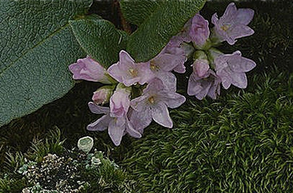
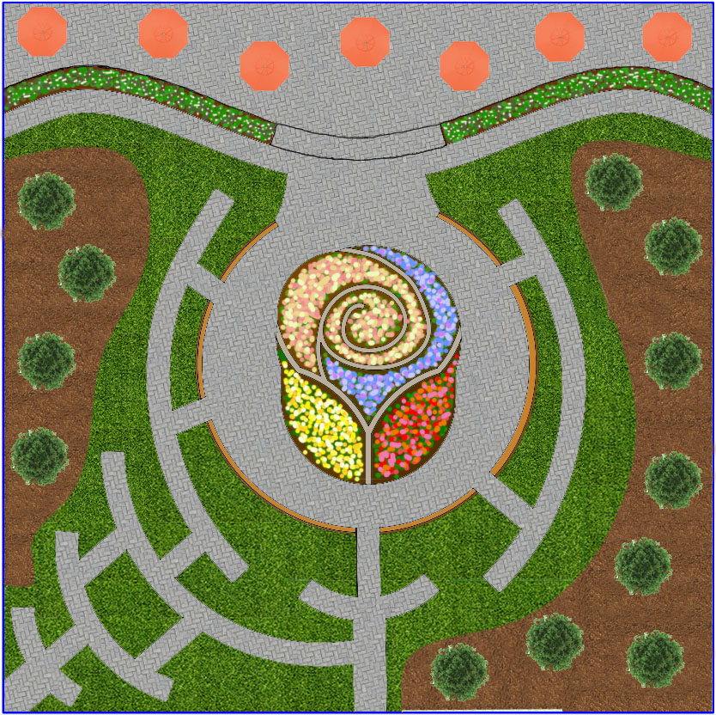
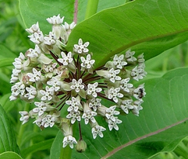
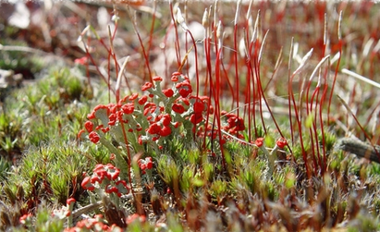
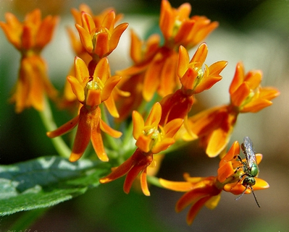
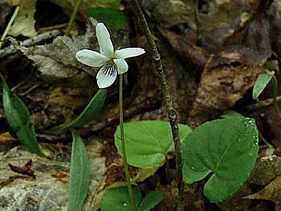
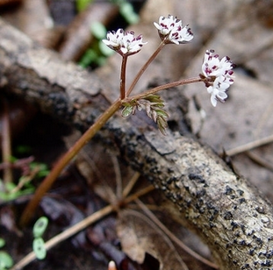
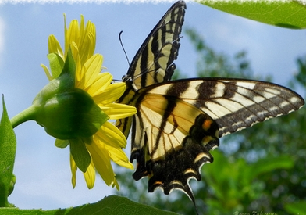
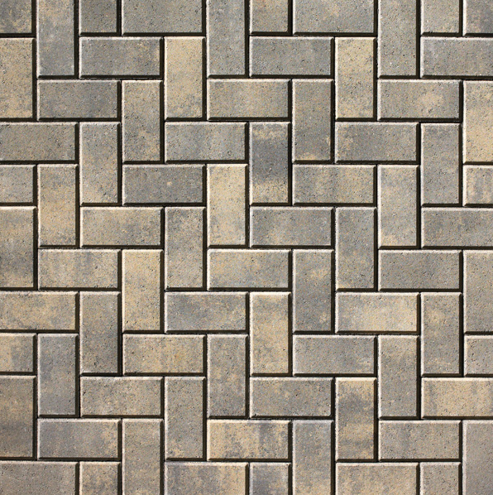
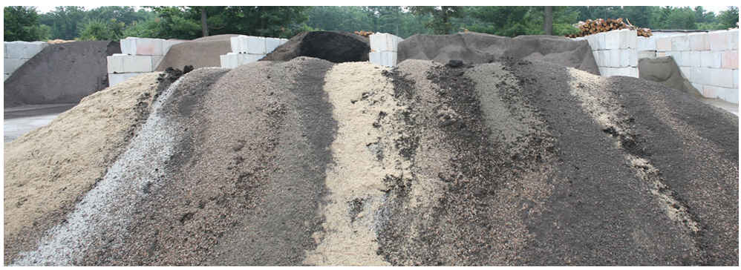
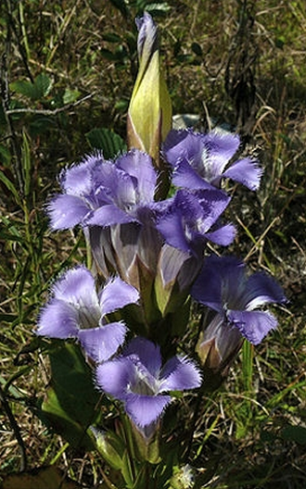
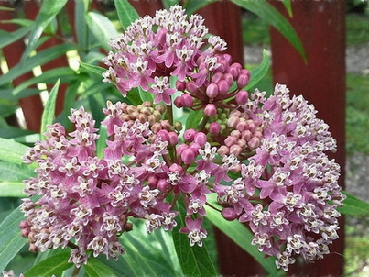
Corporate Headquarters
Introduction
Problem Statement and Solution
Structural Depth
Green Roof Breadth
Loading and Framing
Design and Materials
Enclosures Breadth
Conclusion
Green Roof Breadth- Design and Materials
Design focused around new feature planter
Takes a form symbolic to the building owner
Features plants local to the building area
Walkways shown are 5’ wide
Holland pavers for patio area
  Easy snow removal due to smooth surface
Engineered fill
  Filters rainwater and buffers acid rain
152’
152’
Design obscured for privacy reasons
Notes:
ADA compliant walkways
Step up to patio area
Low shrubs, not trees
Patio will sit on compacted fill in order to maximize versatility for the space
All local flowers shown : cup plant, 3 kinds of milkweed, greater fringed gentian
Benches incorporated around the garden
Gardens within the rose planter step up every 6”, with the yellow garden lowest and the light pink garden highest, spiraling towards the sky

Slide 21
Corporate Headquarters
Introduction
Problem Statement and Solution
Structural Depth
Gravity System
Lateral System
Green Roof Breadth
Enclosures Breadth
Conclusion
Enclosures Breadth

Slide 22
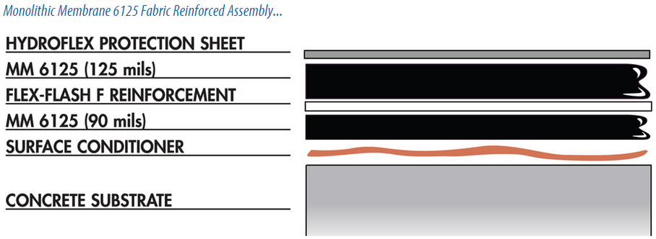
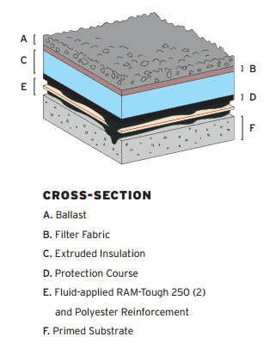
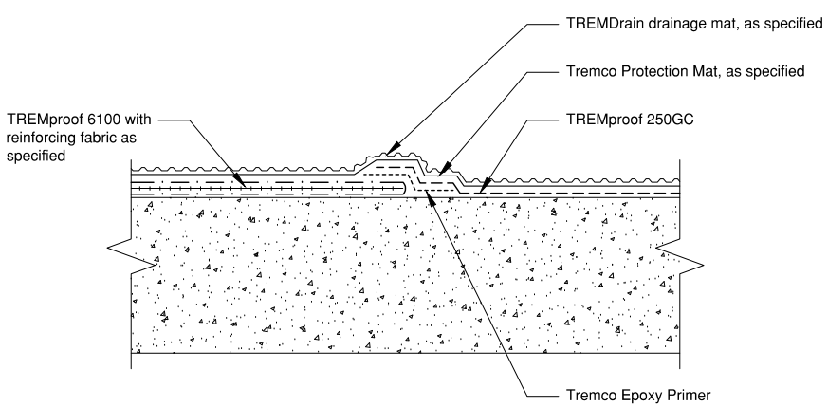
Corporate Headquarters
Introduction
Problem Statement and Solution
Structural Depth
Green Roof Breadth
Enclosures Breadth
Membrane Comparison
Water Testing and Drainage Plan
Conclusion
Enclosures Breadth
Membrane Comparison
American Hydrotech MM6125
Resists animal droppings (+)
No material failure in 50 years (+)
Performed well in fertilizer resistance test (+)
Can only be installed through trained Hydrotech professionals (-)
Barret Company ram-Tough 250
Highest flash point (+)
Highest softening point (+)
Not tested for fertilizer resistance and animal droppings (-)
Tremco TREMproof 6100
Manufactured near the project site (+)
Second highest flash point (+)
Performed well in a pinhole test (+)
Requires special authorization to be applied over lightweight concrete topping (-)
MM6125
ram-Tough 250
TREMproof 6100
Notes:
All monolithic due to fluid applied quality
Rubberized asphalt
90 mils = .09”
125 mils = .125”
Selected MM6125
Flash point is the temperature at which a membrane would ignite
Pinhole test: prod the membrane and look for pinholes

Slide 23
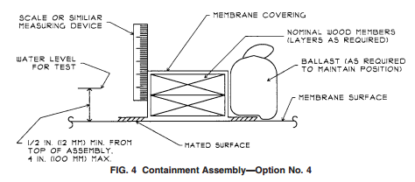
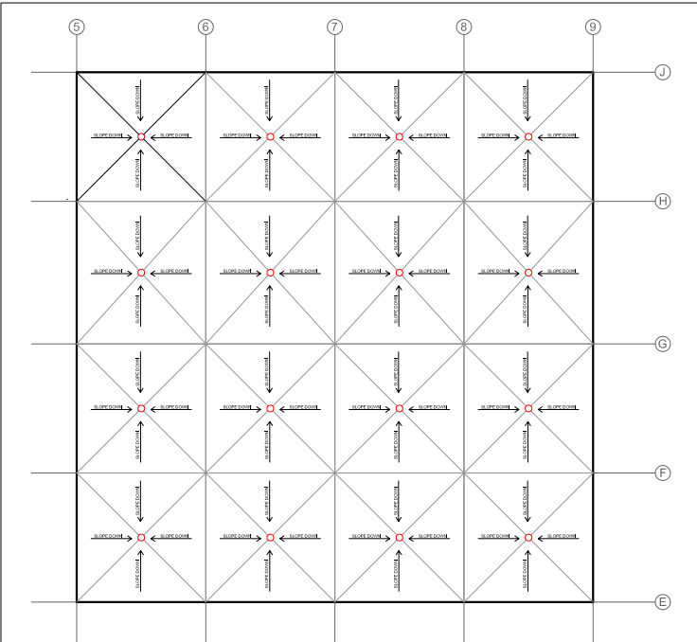
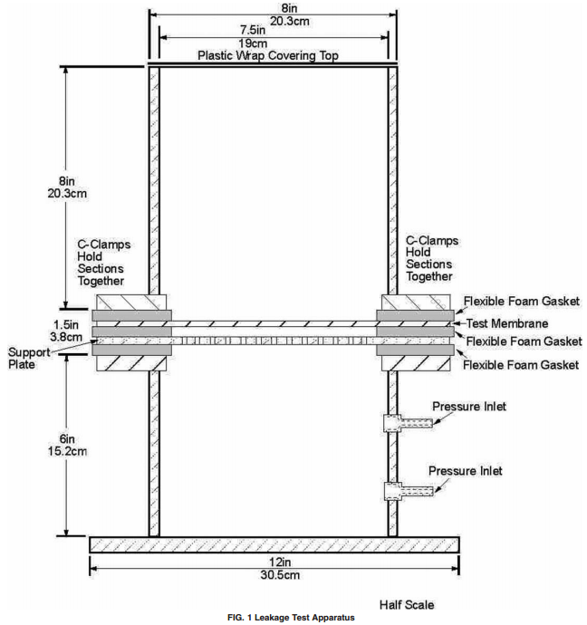
Corporate Headquarters
Introduction
Problem Statement and Solution
Structural Depth
Green Roof Breadth
Enclosures Breadth
Membrane Comparison
Water Testing and Drainage Plan
Conclusion
Enclosures Breadth
Water Testing and Drainage Plan
Leakage Test- ASTM D7281-07
Requires leakage test apparatus
7 day test procedure under 6” of water
Utilizes pressurized air (6.9 kPa)
Flood Test- ASTM D5957-98
Courtyard test
Performed after membrane installation
Requires drains to be plugged
24-72 hour test
1-4” water
New Drainage Plan
one drain per bay
16 drains total
1520 sq ft of membrane area per drain
Tie drains into existing system
Notes:
Flood Test:
Remove drain plugs slowly so that the drainage system doesn’t get ruined
Leakage test: take a 2’x4’ piece of membrane
Exposed to florescent UV condensation
Weathered
6”
Drainage carries less square footage per drain than existing (existing is about 2200 sq ft)

Slide 24
Corporate Headquarters
Introduction
Problem Statement and Solution
Structural Depth
Green Roof Breadth
Enclosures Breadth
Conclusion
Conclusion
More office space was created on the upper three floors of the building
  Approximately 2,000 sq ft per floor, 6,000 sq ft total
new gravity and lateral system were created
Total drift and story drift decreased
Courtyard green roof redesigned
New watertight assembly chosen
Image Courtesy: RTKL

Slide 25
Corporate Headquarters
Introduction
Problem Statement and Solution
Structural Depth
Green Roof Breadth
Enclosures Breadth
Conclusion
Acknowledgements
RTKL Corporation
WJE Cleveland
AE Faculty
Heather Sustersic
AE 2015
Family and Friends
Image Courtesy: RTKL

Slide 26
Corporate Headquarters
Introduction
Problem Statement and Solution
Structural Depth
Green Roof Breadth
Enclosures Breadth
Conclusion
AE Senior Thesis
April 13th, 2015
Mary Julia Haverty
Structural Option
Advisor H. Sustersic
Questions
Image Courtesy: RTKL and The Village Newspaper

